Slide 1

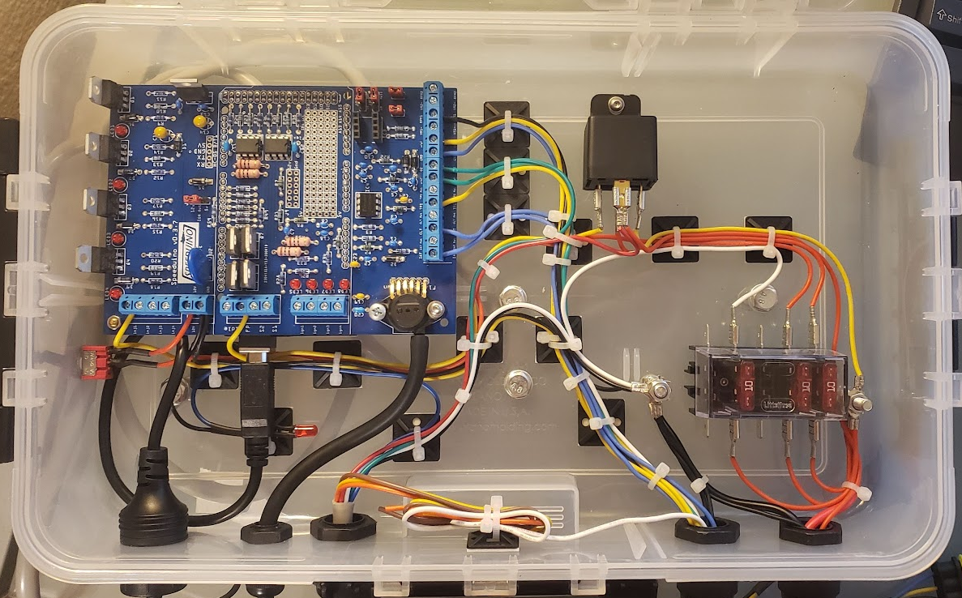
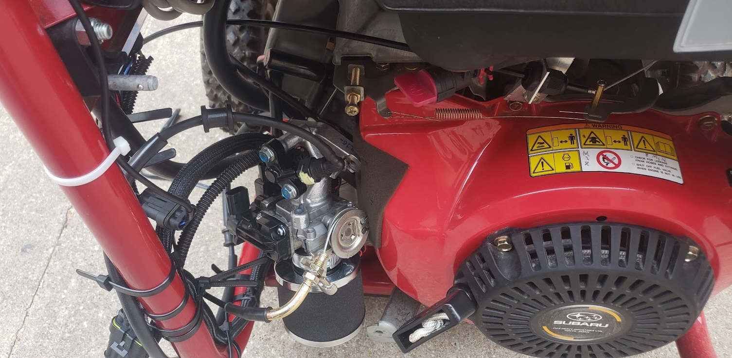
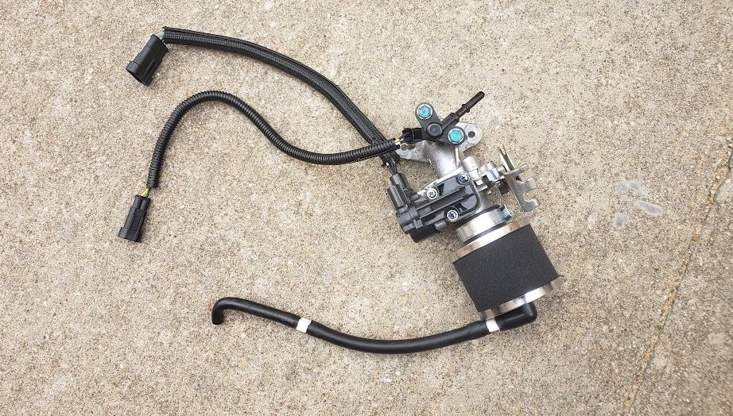
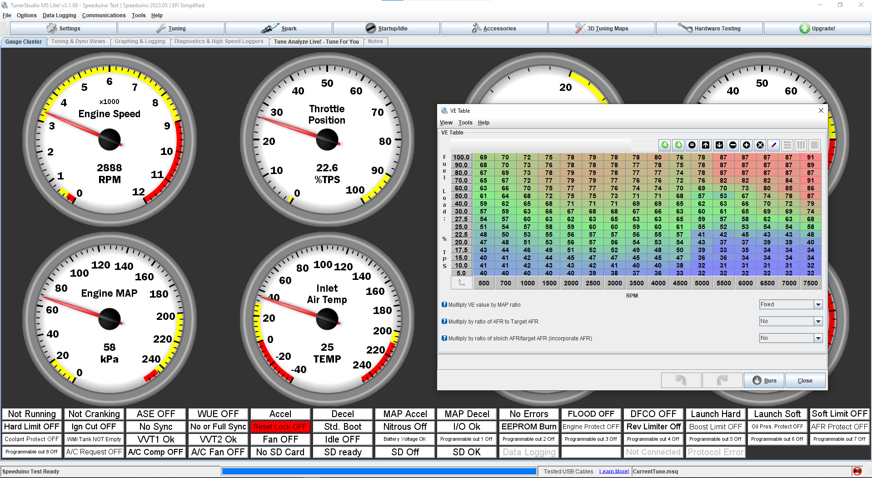
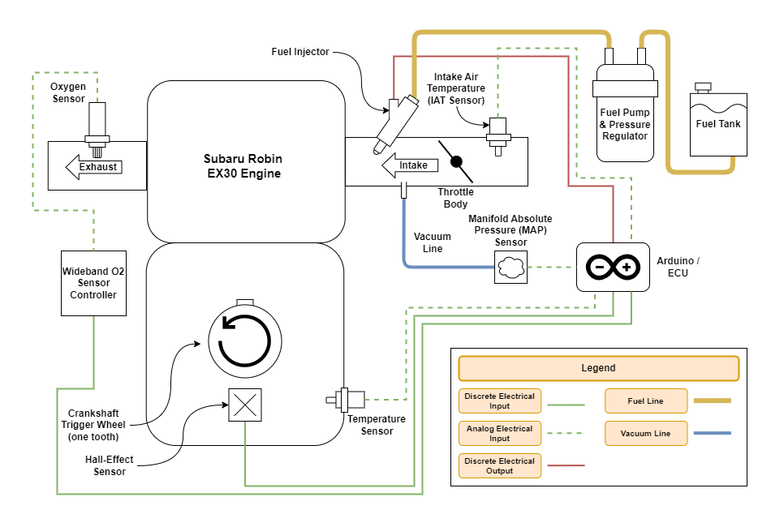
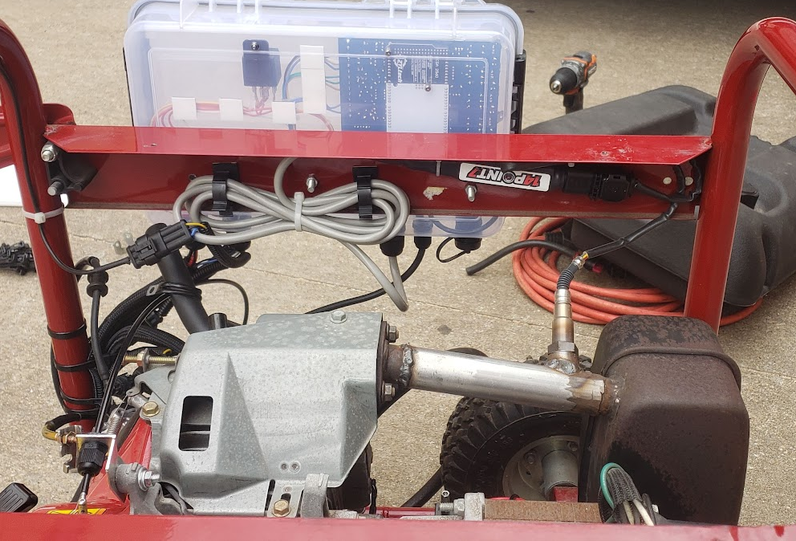
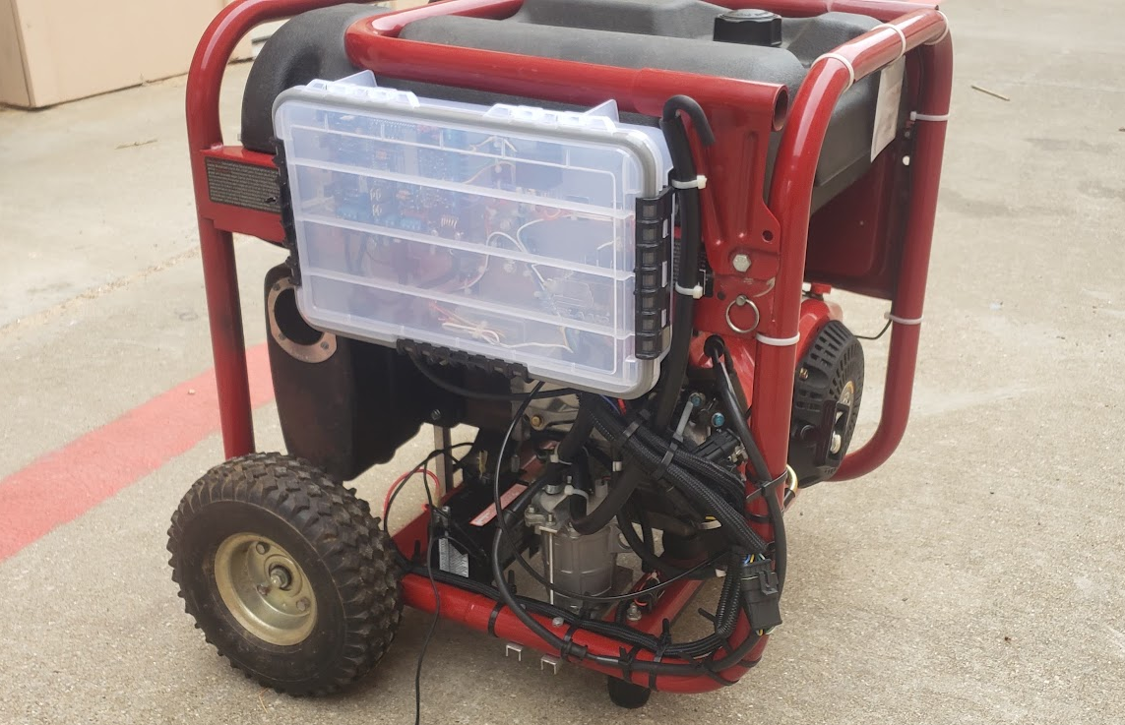
Small Gasoline Engine Electronic Fuel Injection System
Griffin White, Prof. Timothy Nix – The University of Texas at Tyler Honors College
Background
EFI System Design & Fabrication
Experiment Process
Gasoline internal combustion engines are controlled by metering the amount of fuel and air provided to the engine (i.e. throttle).
While the air and fuel is being metered, the engine must be provided with a consistent and appropriate air to fuel ratio (AFR).
In general, the ideal AFR is (by mass) 14.7 parts atmospheric air and 1 part gasoline.
An AFR below 14.7:1 is considered “rich”; there is an excess of gasoline and not enough oxygen to completely combust the fuel.
An AFR above 14.7:1 is considered “lean”; there is an excess of air and more than enough oxygen to completely combust the fuel.
This 14.7:1 ratio can be difficult to achieve. Engines operate in a dynamic environment, and many variables can affect an engine’s fuel needs. Such as: altitude / air density, engine temperature, ambient temperature, fuel composition, engine load, etc.
In the past, most engines metered fuel via a carburetor. This a mechanical static fuel metering device. As a static metering device, it struggles to meet an engine’s dynamic needs. Many small engines (used in lawn mowers, generators, etc.) still use carburetors.
Most modern engines use electronic fuel injection (EFI). This is a computerized dynamic fuel meting system. As a dynamic metering system, it is better suited to meet an engine’s dynamic needs.
A 5000-watt AC generator, powered by a 9 HP four-stroke gasoline engine, acts as the testbed for the EFI system. From the factory, this machine is fitted with a simple carburetor.
The engine had none of the necessary sensors / electrical systems to support EFI. The entire EFI system was fabricated from scratch.
The system uses a Speeduino v0.3 standalone ECU, programmed via the EFI Analytics TunerStudio tuning software.
The ECU operates using a TPS control algorithm, non-sequential injection, and closed-loop fuel trim adjustment.
Components were repurposed from various applications.
The throttle body came from a 2019-2022 Honda C125 scooter.
The fuel pump came from a 2007-2013 Honda TRX420 ATV.
Some fabrication was required. A custom electrical system and full wiring harness was made. The exhaust system was modified to fit an O2 sensor. A custom throttle cable was made to connect the throttle body to the engine’s throttle governor. Etc.
Component List
Honda C125 Throttle Body Assembly
Fuel Injector
Throttle Position Sensor
Intake Air Temp Sensor
High-Pressure Fuel Line
Crank Position Hall-Effect Sensor
Honda TRX420 Fuel Pump
GM Coolant Temp Sensor
Speeduino v0.3 ECU Kit
ECU Board and Components
Arduino Mega 2560
Spartan 3 Lite Wideband O2 Kit
Wideband O2 Controller
Bosch 17323 O2 Sensor
12v Battery
Custom Wiring Harness
Custom Exhaust Manifold
Custom Throttle Cable
Custom Air Filter / Breather Line
The experiments gauged the fuel consumption of the generator, comparing the original carburetor to the EFI system.
For each trial, 100 ml of gasoline was measured into an external fuel tank. The engine was run until the tank was empty, and the time elapsed was recorded.
The generator was tested under two conditions: No electrical load (idle) and a moderate electrical load (1500-watt space heater).
Each test was conducted with both the carburetor and the EFI system.
Engine performance (RPM, AFR, temp, etc.) was logged via the EFI Analytics TunerStudio software. This data was then analyzed in Microsoft Excel.
In total, 4 different experiments were conducted, with 10 trials each.
Conclusions
The EFI system improved the engine’s efficiency.
The EFI system achieved better fuel consumption and a leaner, more consistent, air fuel ratio.
After switching to EFI, the fuel efficiency increased by 68% at idle and 19% while under load.
The EFI system used less fuel under load (1.358 l/h) than the carburetor used at idle (1.442 l/h).
The AFR standard deviation decreased by 30% at idle and by 15% while under load.
Project Goals
Carburetor – No Load (Idle) Average of Results (TRIMMEAN: 20%)
Run Time (sec) | Run Time (mm:ss) | Fuel Usage (l/h) | Entire Duration
250 | 4:10 | 1.442
Avg AFR | Std Dev | Dev from 14.7 | 30 Second Delay
10.340 | 0.366 | 4.360
Min AFR (Rich) | Max AFR (Lean) | Range
10 | 12.325 | 2.325
EFI – No Load (Idle) Average of Results (TRIMMEAN: 20%)
Run Time (sec) | Run Time (mm:ss) | Fuel Usage (l/h) | Entire Duration
420 | 07:00 | 0.858
Avg AFR | Std Dev | Dev from 14.7 | 30 Second Delay
13.355 | 0.257 | 1.345
Min AFR (Rich) | Max AFR (Lean) | Range
12.763 | 14.3 | 1.55
Design, fabricate, and tune an electronic fuel injection (EFI) system for a carbureted engine.
Compare the performance of this electronic fuel injection system to the engine’s original carburetor.
Fig. 1 – Speeduino ECU and Electronics
Fig. 2 – Throttle Body Installed on Engine
Carburetor – 1500W Load Average of Results (TRIMMEAN: 20%)
Run Time (sec) | Run Time (mm:ss) | Fuel Usage (l/h) | Entire Duration
222 | 3:42 | 1.620
Avg AFR | Std Dev | Dev from 14.7 | 30 Second Delay
11.199 | 0.312 | 3.501
Min AFR (Rich) | Max AFR (Lean) | Range
10.238 | 12.413 | 2.175
EFI – 1500W Load Average of Results (TRIMMEAN: 20%)
Run Time (sec) | Run Time (mm:ss) | Fuel Usage (l/h) | Entire Duration
265 | 4:25 | 1.358
Avg AFR | Std Dev | Dev from 14.7 | 30 Second Delay
12.511 | 0.266 | 2.189
Min AFR (Rich) | Max AFR (Lean) | Range
11.863 | 13.338 | 1.475
EFI System Overview
Fig. 3 – Screenshot of TunerStudio Software
Fig. 4 – Throttle Body Assembly
Fig. 5 – Modified Exhaust System & O2 Sensor
Fig. 6 – Generator with Complete EFI System

